Slide 1


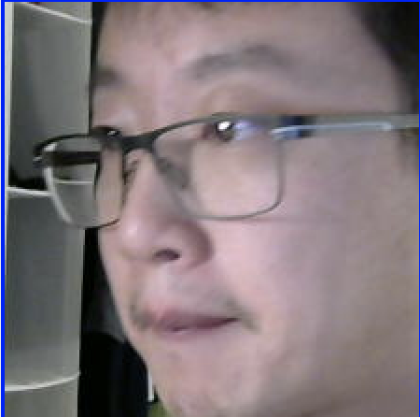

** Each box is a docker container
JETSON
CLOUD INSTANCE
paho
paho
IBM
SDK
OPEN CV
connection jetson
topic face_cutter/camera-broker1
address forwarder:1883
**default settings**
connection bridge-01
topic face_cutter/camera-broker1 both 0
address <ip>:1883

